Slide 1


Slide 2
Chains

Slide 3


LangChain
Now that we’ve learned about Model Input and Outputs and Data Connections, we can finally learn about chains!
Chains allows us to link the output of one LLM call as the input of another call.
Langchain also provides many built-in chain functionalities, like chaining document similarity searches with other LLM calls, actions that we previously constructed manually with Langchain.

Slide 4
LangChain
Chain Section Overview
LLMChain
SimpleSequentialChain
SequentialChain
LLMRouterChain
TransformChain
OpenAI Function Calling
MathChain
AdditionalChains
Chain Exercise and Solution

Slide 5
Let’s get started!

Slide 6
LLMChain

Slide 7
LangChain
Just like our most basic LLM and ChatModel calls earlier in Model IO, Chains have a basic building block known as an LLMChain object.
You can think of the LLMChain as just a simple LLM call that will have an input and an output.
Later on we can use these objects in sequence to create more complex functionality!

Slide 8
SimpleSequentialChain

Slide 9
LangChain
SimpleSequentialChain
Now that we understand how to use the LLMChain object, we can chain them together to create more complex functionality with Langchain.

Slide 10
LangChain
SimpleSequentialChain
LLMChain
LLMChain
LLMChain

Slide 11
LangChain
SimpleSequentialChain
LLMChain
LLMChain
LLMChain
SimpleSequentialChain

Slide 12
LangChain
SimpleSequentialChain
LLMChain
LLMChain
LLMChain
SimpleSequentialChain

Slide 13
SequentialChain

Slide 14
LangChain
SequentialChains are very similar to SimpleSequentialChains, but allow us to have access to all the outputs from the internal LLMChains.
Let’s explore an example!

Slide 15
LLMRouterChain

Slide 16
LangChain
LLMRouterChains can take in an input and redirect it to the most appropriate LLMChain sequence.
The Router accepts multiple potential destination LLMChains and then via a specialized prompt, the Router will read the initial input, then output a specific dictionary that matches up to one of the potential destination chains to continue processing.

Slide 17
LangChain
LLMRouterChains can take in an input and redirect it to the most appropriate LLMChain sequence.
LLMChain
LLMChain

Slide 18
LangChain
LLMRouterChains can take in an input and redirect it to the most appropriate LLMChain sequence.
Case One
LLMChain
Case Two
LLMChain

Slide 19
LangChain
LLMRouterChains can take in an input and redirect it to the most appropriate LLMChain sequence.
Customer Support
LLMChain
Internal Employees
LLMChain

Slide 20
LangChain
LLMRouterChains can take in an input and redirect it to the most appropriate LLMChain sequence.
Customer Support
LLMChain
Input
LLMRouter
Internal Employees
LLMChain

Slide 21
LangChain
Let’s explore an example of LLMRouterChain!

Slide 22
TransformChain

Slide 23
LangChain
TransformChain allows us to easily pass in our own custom transformation functions within chain, let’s explore a quick example!

Slide 24
OpenAI Function
Calling

Slide 25
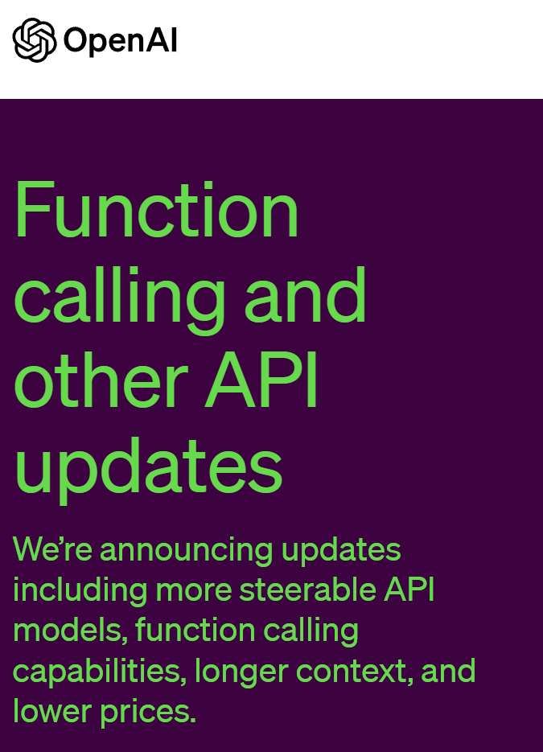
LangChain
In 2023 with the wide-release of GPT-4 to all API users, OpenAI also discussed increased capabilities of their chat models to internally call functions.

Slide 26
LangChain
Using the Chat Models from OpenAI in this fashion can allow you to have even more certainty in JSON outputs from OpenAI.

Slide 27
LangChain
Keep in mind that due to Langchain’s own existing capabilities that we’ve explored, you may find this as just a duplication of other Model IO discussions we’ve had using Pydantic to achieve JSON output.

Slide 28
LangChain
Let’s explore a quick example of using OpenAI Chat Models to specify a required JSON output without needing to use Pydantic!

Slide 29
MathChain

Slide 30
LangChain
There are many built-in chains for common tasks, let’s explore how we can search the documentation for an additional built-in chain, understand how it works, and utilize it, starting with the MathChain!

Slide 31
Additional Chains

Slide 32
LangChain
There are many additional pre-built chains, let’s take a look at two of the most commonly used ones, for Document QA.
We’ll see that a lot of our own work in the Data Connections section can easily be duplicated with just a few lines of code with the pre-built chains!

Slide 33
Chains Exercise

Slide 34
Chains Exercise
Solution

